Slide 1
Hibernate

Slide 2
Hibernate Inheritance
SINGLE_TABLE(default)
JOINED
TABLE_PER_CLASS

Slide 3
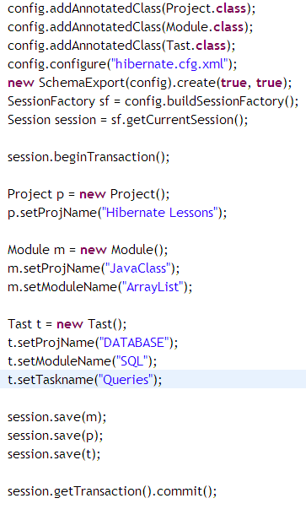

Slide 4
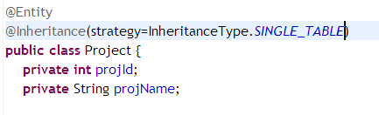
Default Strategy

Slide 5
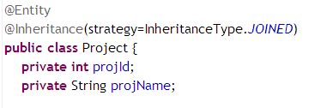
JOINED

Slide 6
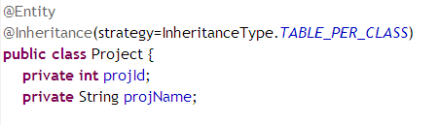
TABLE_PER_CLASS
Note: There might be some errors, due to relations.

Slide 7
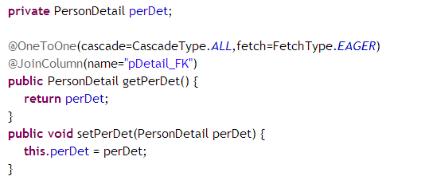
One to One
Person
Note: for OneToOne by default fetch type is EAGER
for OneToMany by default fetch type is LAZY

Slide 8
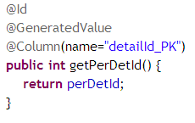
Continued…..
PersonDetail

Slide 9

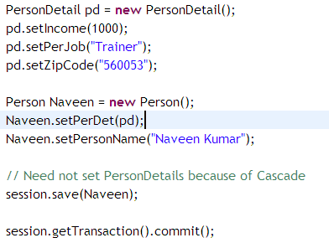
Continued….
Main Method

Slide 10
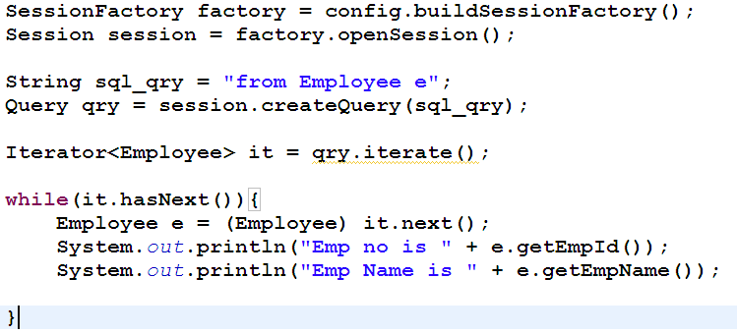
HQL
Note: Upto Hibernate 3.x

Slide 11
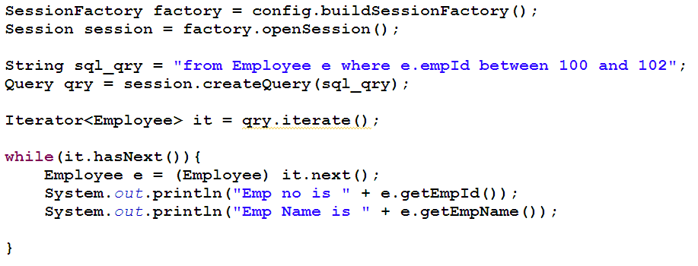
HQL - between
Note: Upto Hibernate 3.x

Slide 12
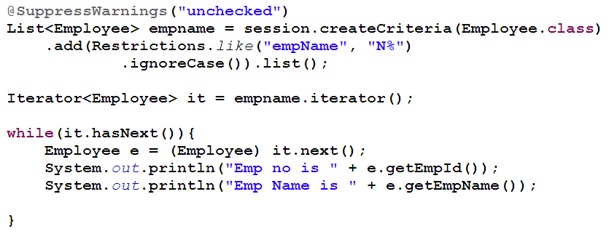
HQL Restriction
Note: Upto Hibernate 3.x

Slide 13
Criteria – Hibernate 5
Refer the API Document
http://docs.jboss.org/hibernate/orm/current/userguide/html_single/Hibernate_User_Guide.html#appendix-legacy-criteria

Slide 14
Criteria Query
The basic steps to create a Criteria query are –
1 - Create a CriteriaBuilder instance by calling the Session.getCriteriaBuilder() method.
CriteriaBuilder builder = session.getCriteriaBuilder();
2 - Create a query object by creating an instance of the CriteriaQuery interface.
CriteriaQuery<T> query = builder.createQuery(T.class);
3 - Set the query Root by calling the from() method on the CriteriaQuery object to define a range variable in FROM clause.
Root<T> root = query.from(T.class);

Slide 15
Criteria Query - Contd
4 - Specify what the type of the query result will be by calling the select() method of the CriteriaQuery object.
query.select(root);
5 - Prepare the query for execution by creating a org.hibernate.query.Query instance by calling the Session.createQuery() method, specifying the type of the query result.
Query<T> q = session.createQuery(query);
6 - Execute the query by calling the getResultList() or getSingleResult() method on the org.hibernate.query.Query object.
List<T> list = q.getResultList();

